Slide 1
Title of Topic: Keys and Integrity Constraints Course Code: 23IT201 Course Title: DataBase Management Systems Session Number: 6 Academic Year: 2024 - 2025 (Even Sem)
23IT201- DATABASE MANAGEMENT SYSTEMS
MODULE - INTRODUCTION

Slide 2
1. Introduction to DBMS, Characteristics of DBMS, DBMS vs File Systems, need for DBMS. 2. Three Level DBMS Architecture. 3. Data Models, Introduction, Benefits, and Phases. ER Diagrams – Symbols, Components, Relationships, Weak entities, Attributes, Cardinality. 4.Relational Algebra, Domain Relational Calculus, Tuple Relational Calculus, 5. Keys - primary Key, Foreign Key.
MODULE 1-INTRODUCTION
Module 1 – INTRODUCTION
MODULE 1-INTRODUCTION
2

Slide 3
MODULE 1-INTRODUCTION
Keys and Integrity Constraints
Topics to be Covered
Keys in DBMS
Integrity Constraints
Domain Constraints
Entity Integrity Constraints
Referential Integrity Constraints
Key Constraints
MODULE 1-INTRODUCTION

Slide 4
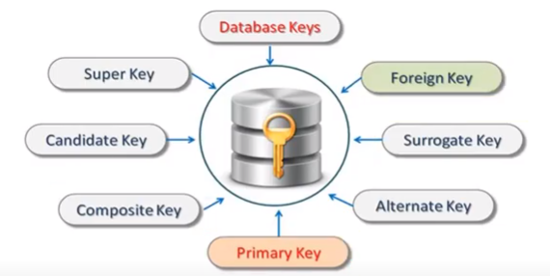
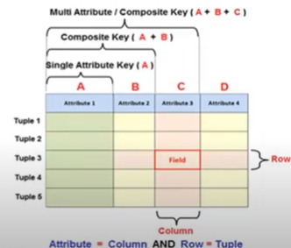

MODULE 1-INTRODUCTION
Keys in DBMS
Ensure that a table record can be uniquely identified
Allows to establish a relationship between tables and identify the relation between tables
Help to enforce identity and integrity in the relationship
Keys in DBMS:
MODULE 1-INTRODUCTION

Slide 5
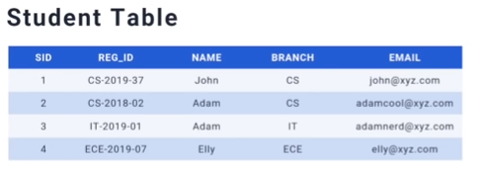

MODULE 1-INTRODUCTION
Keys in DBMS
Super Key
Every key in a table
An attribute or a set of attributes that can be used to identify rows in a table
May have additional attributes that are not needed for unique identification
Super Keys
MODULE 1-INTRODUCTION

Slide 6

MODULE 1-INTRODUCTION
Keys in DBMS
Candidate Key
Set of attributes that uniquely identify tuples in a table
A super key with no repeated attributes
Minimal subset of super key
If any proper subset of a super key is a super key then that key cannot be a candidate key
Candidate Keys
MODULE 1-INTRODUCTION

Slide 7
MODULE 1-INTRODUCTION
Keys in DBMS
Properties of Candidate Key
It must contain unique values
Candidate key may have multiple attributes
Must not contain null values
It should contain minimum fields to ensure uniqueness
Uniquely identify each record in a table
MODULE 1-INTRODUCTION

Slide 8
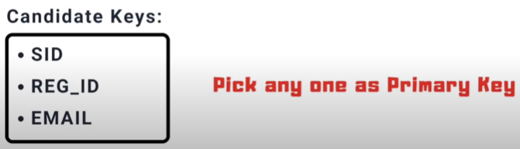
MODULE 1-INTRODUCTION
Keys in DBMS
Primary Key
An attribute or a set of attributes in a table that uniquely identify every row in that table
Can't be a duplicate meaning the same value can't appear more than once in the table
A table cannot have more than one primary key
Primary Key
MODULE 1-INTRODUCTION

Slide 9
MODULE 1-INTRODUCTION
Keys in DBMS
Rules for defining Primary Key
Two rows can't have the same primary key value
It is must for every row to have a primary key value
The primary key field cannot be null
The value in a primary key column can never be modified or updated if any foreign key refers to that primary key
MODULE 1-INTRODUCTION

Slide 10

MODULE 1-INTRODUCTION
Keys in DBMS
Alternate Key
An attribute or a set of attributes in a table that uniquely identify every row in that table
A table can have multiple choices for a primary key but only one can be set as the primary key
All the keys which are not primary key are called an Alternate Key
Alternate Key
MODULE 1-INTRODUCTION

Slide 11
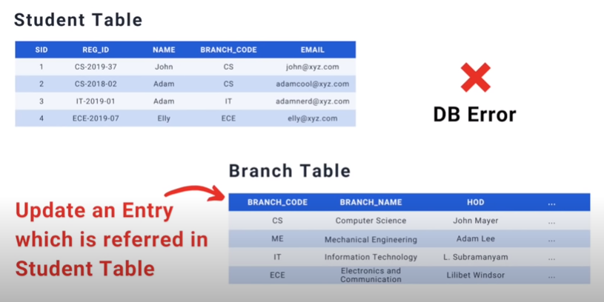
MODULE 1-INTRODUCTION
Keys in DBMS
Foreign Key
An attribute that creates a relationship between two tables
Maintain data integrity and allow navigation between two different instances of an entity
Acts as a cross-reference between two tables as it references the primary key of another table
Foreign key ➔ BRANCH_CODE
MODULE 1-INTRODUCTION

Slide 12
MODULE 1-INTRODUCTION
Keys in DBMS
Composite Key
Combination of two or more attributes that uniquely identify rows in a table
The combination of attributes guarantees uniqueness, though individually uniqueness is not guaranteed
Hence, they are combined to uniquely identify records in a table
E.g., (SID,REG_ID),(REG_ID,EMAIL),(EMAIL,SID),(SID,REG_ID,EMAIL) etc… all are composite keys
MODULE 1-INTRODUCTION

Slide 13
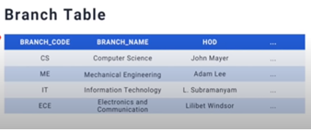
MODULE 1-INTRODUCTION
Keys in DBMS
Compound Key
Two or more attributes that allows to uniquely recognize a specific record
Each attribute may not be unique by itself within the database
However, when combined with the other attribute or attributes the combination of composite keys become unique
E.g., (REG_ID,BRANCH_CODE) is a compound key because branch attribute is a foreign key
MODULE 1-INTRODUCTION

Slide 14
MODULE 1-INTRODUCTION
Keys in DBMS
Surrogate Key
If a relation has no attribute which can be used to identify the data stored in it, then we create an attribute for this purpose
Adds no meaning to the data but serves the sole purpose of identifying rows uniquely in a table
Created when there is no natural primary key
Do not lend any meaning to the data in the table and is usually an integer
Value generated right before the record is inserted into a table
MODULE 1-INTRODUCTION

Slide 15
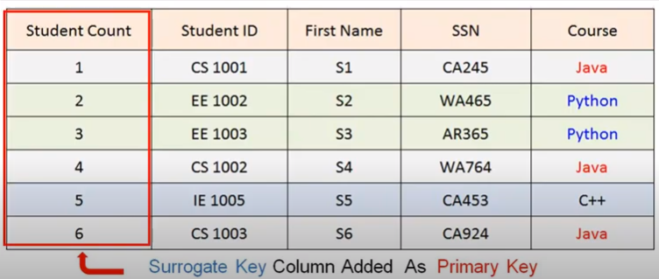
MODULE 1-INTRODUCTION
Keys in DBMS
Surrogate Key
Allowed when
No property has the parameter of the primary key
In the table when the primary key is too big or complicated
MODULE 1-INTRODUCTION

Slide 16
MODULE 1-INTRODUCTION
Integrity Constraints
Set of rules
Used to maintain the quality of information
DataBase is not permitted to violate
Ensure that inserting data, updating data and other processes have to be performed in such a way that data integrity is not affected
Used to guard against accidental damage to the database
Used to ensure accuracy and consistency of the data in a relational database
Every relation has some constraints (condition) to make a relation valid is known as relational integrity constraints
Integrity Constraints:
MODULE 1-INTRODUCTION

Slide 17
MODULE 1-INTRODUCTION
Integrity Constraints
Types of Integrity Constraints
Domain Constraints
Entity Integrity Constraints
Referential Integrity Constraints
Key Constraints
MODULE 1-INTRODUCTION

Slide 18
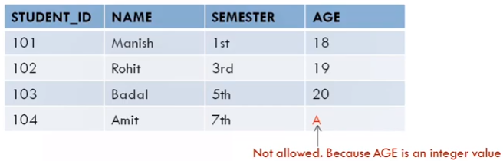
MODULE 1-INTRODUCTION
Domain Constraints
Definition of a valid set of values for an attribute
Defines data type, length or size
Data type of domain constraints include string, character, integer, time, date, currency, etc…
Value of the attribute must be available in the corresponding domain
E.g., If there is a column (attribute) of integer values then alphabet cannot be placed in it, since the attribute had only integer values as its domain
MODULE 1-INTRODUCTION

Slide 19
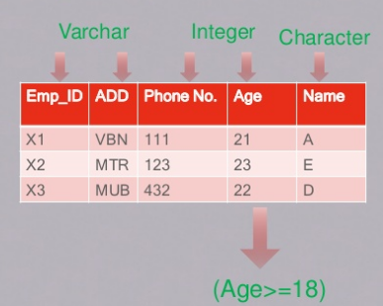
MODULE 1-INTRODUCTION
Domain Constraints
Every attribute is bound to have specific range and/or specific values
E.g., Age cannot be 0 or less, Name cannot be in integer format
Null value is allowed
The value is unique or not for an attribute
MODULE 1-INTRODUCTION

Slide 20

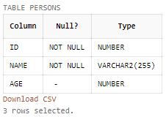
MODULE 1-INTRODUCTION
Domain Constraints
E.g., CREATE TABLE persons(ID int NOT NULL, Name varchar(255) NOT NULL, Age int, CHECK (Age>=18));
Output
DESC persons;
INSERT INTO persons VALUES('1','','26');
MODULE 1-INTRODUCTION

Slide 21

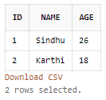
MODULE 1-INTRODUCTION
Domain Constraints
INSERT INTO persons VALUES('1','Sindhu','26');
INSERT INTO persons VALUES('2','Karthi','18');
INSERT INTO persons VALUES('3','Sandhya','15');
SELECT * FROM persons;
MODULE 1-INTRODUCTION

Slide 22
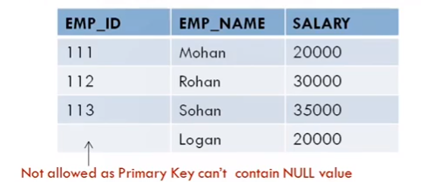
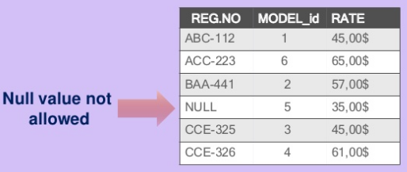
MODULE 1-INTRODUCTION
Entity Integrity Constraints
States that primary key value cannot be null
Because the primary key value is used to identify individual rows in relation and if the primary key has a null value, then those rows cannot be identified
Table can contain a null value other than the primary key field
Null value is different from zero value or space
Entity integrity constraints assure that a specific row in a table can be identified
MODULE 1-INTRODUCTION

Slide 23
MODULE 1-INTRODUCTION
Entity Integrity Constraints
E.g., CREATE TABLE persons(ID int PRIMARY KEY, LastName varchar(255) NOT NULL, FirstName varchar(255),Age int);
Output
INSERT INTO persons VALUES('1','ranjith','sindhu','26');
INSERT INTO persons VALUES('1','karthi','sindhu','28');
MODULE 1-INTRODUCTION

Slide 24
MODULE 1-INTRODUCTION
Entity Integrity Constraints
E.g., CREATE TABLE persons(ID int NOT NULL, LastName varchar(255) NOT NULL, FirstName varchar(255),Age int,CONSTRAINT PK_person PRIMARY KEY(ID,LastName));
Output
INSERT INTO persons VALUES('1','ranjith','sindhu','26');
INSERT INTO persons VALUES(‘2','ranjith','karthi','30');
MODULE 1-INTRODUCTION

Slide 25
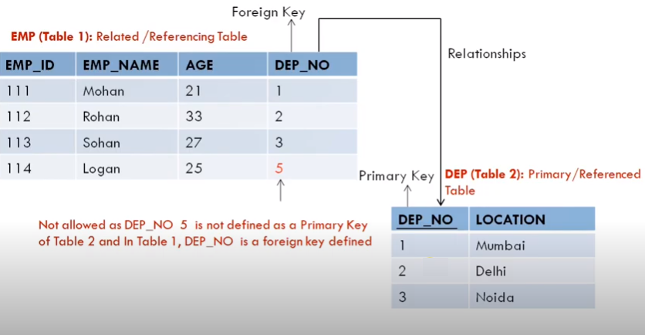
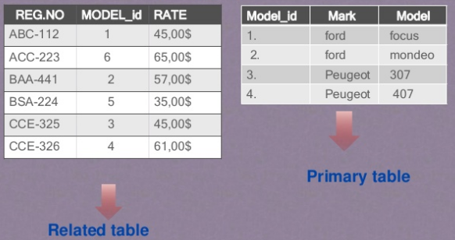
MODULE 1-INTRODUCTION
Referential Integrity Constraints
Specified between two tables and is used to maintain the consistency among rows between the two tables
Implemented through foreign key, which is a key attribute of a relation that can be referred in other relation
Foreign key is a field (or collection of fields) in one table that refers to the primary key in another table
MODULE 1-INTRODUCTION

Slide 26
MODULE 1-INTRODUCTION
Referential Integrity Constraints
Rules
A record cannot be deleted from a primary table if matching records exist in a related table
A primary key value cannot be changed in the primary table if that record has related records
A value cannot be entered in the foreign key field of the related table that doesn’t exist in the primary key of the primary table
A null value can be entered in the foreign key, specifying that the records are unrelated
MODULE 1-INTRODUCTION

Slide 27
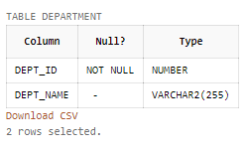
MODULE 1-INTRODUCTION
Referential Integrity Constraints
E.g., CREATE TABLE department(Dept_id int NOT NULL,Dept_Name varchar(255),PRIMARY KEY (Dept_id));
Output
DESC department;
INSERT INTO department VALUES('1','CSE');
MODULE 1-INTRODUCTION

Slide 28
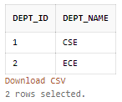
MODULE 1-INTRODUCTION
Referential Integrity Constraints
INSERT INTO department VALUES('','ECE');
INSERT INTO department VALUES('2','ECE');
SELECT * FROM department;
CREATE TABLE employee(ID int NOT NULL,Name varchar(255),Dept_id int,PRIMARY KEY(ID),FOREIGN KEY(Dept_id) REFERENCES department(Dept_id));
MODULE 1-INTRODUCTION

Slide 29
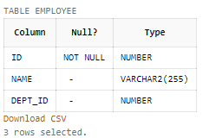
MODULE 1-INTRODUCTION
Referential Integrity Constraints
DESC employee;
INSERT INTO employee VALUES('101','Sindhu','1');
INSERT INTO employee VALUES('106','Sandhya','2');
INSERT INTO employee VALUES('103','Sindhu','5');
MODULE 1-INTRODUCTION

Slide 30
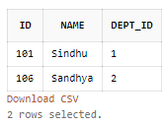
MODULE 1-INTRODUCTION
Referential Integrity Constraints
INSERT INTO employee VALUES('101','Ranjith','1');
SELECT * FROM employee;
DROP TABLE department;
DROP TABLE employee;
DROP TABLE department;
MODULE 1-INTRODUCTION

Slide 31
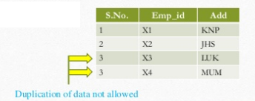
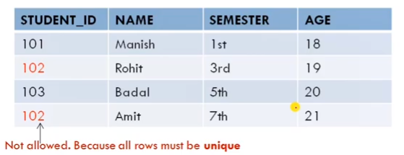
MODULE 1-INTRODUCTION
Key Constraints
Keys are the entity set that is used to identify an entity within its entity set uniquely
An entity set can have multiple keys, out of which one key will be the primary key
A primary key can contain a unique and null value in the relational table
No two rows can have identical values with respect to key attribute
MODULE 1-INTRODUCTION

Slide 32
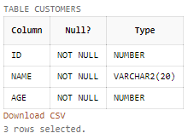
MODULE 1-INTRODUCTION
Key Constraints
E.g., CREATE TABLE customers(ID int NOT NULL,Name varchar(20) NOT NULL,Age INT NOT NULL UNIQUE,PRIMARY KEY (ID));
Output
INSERT INTO customers VALUES('1','Sindhu','26');
INSERT INTO customers VALUES('2','Sandhya','26');
INSERT INTO customers VALUES('2','Sandhya','30');
DESC customers;
MODULE 1-INTRODUCTION

Slide 33
MODULE 1-INTRODUCTION
Keys and Integrity Constraints
Summary
Keys in DBMS
Integrity Constraints
Domain Constraints
Entity Integrity Constraints
Referential Integrity Constraints
Key Constraints
MODULE 1-INTRODUCTION

Slide 34
MODULE 1-INTRODUCTION
Keys and Integrity Constraints
Try Yourself
Create a Voters database with the following constraints
Age >=18
ID should be unique
Phone number as primary key
Aadhar number as foreign key
Name should not be null
MODULE 1-INTRODUCTION

Slide 35
MODULE 1-INTRODUCTION
MODULE II CONSTRAINTS AND SQL COMMANDS
MODULE 1-INTRODUCTION

